Slide 1
Conservation Finance: A Framework
David Meyers, John Bohorquez, Tracey Cumming, Lucy Emerton, Onno van den Heuvel, Massimiliano Riva, Ray Victurine

Slide 2
The CFA is the leading global professional alliance for conservation finance experts, practitioners, and organizations.
Our mission is to promote awareness, expertise, and innovation in conservation finance globally.
Working Groups
Practice Standards
White Papers and Reports
Global Network / Webinars

Slide 3
https://www.conservationfinancealliance.org/cfa-white-paper

Slide 5
Finance Needs
$US 52 BN
$US 400 BN

Slide 7
Conservation Finance: A Framework – Main Messages
More money for conservation is necessary but not sufficient
Work both sides of equation: reduce costs as well as increase cash flows until resources available = resources required
Establish resilient, self sustaining, long-term solutions – think in systems

Slide 8
Defining Conservation Finance
“mechanisms and strategies that generate, manage, and deploy financial resources and align incentives to achieve nature conservation outcomes.”
Notes:
Meaning of “Finance”
To finance versus to fund (verbs)
Finance (noun)
1. The management of large amounts of money, especially by governments or large companies.
1.1 Monetary support for an enterprise.
1.2 The monetary resources and affairs of a state, organization, or person.

Slide 9
Elements of Conservation Finance
Generate
Manage
Deploy
Align Incentives

Slide 10
Conservation Finance Interventions
Deliver Better
Decrease Cost of Conservation
Increase Capital for Conservation
Discourage harmful actions
Incentives for positive actions
Money
Behavior
↓Negative
↑Positive

Slide 11
Elements of a Finance Solution / Mechanism
Finance Source
Instrument 1
Intermediary
Instrument 2
Beneficiary / Recipient
Actions
Conservation Results
M&E
Economic Model: What are the economics behind the solution?
Instrument 3
Notes:
An action-driven term – “solution” – characterized and described by:
Finance Source - sources of finance the solution relies upon.
Intermediary - lead agent or intermediaries tasked to manage the operationalization of the solution
Beneficiaries - or principal stakeholders that either receive the financing or are the targets of the instrument.
Instruments - used to mobilize, collect, manage and disburse the funding. They can be strictly financial instruments like bonds or equities, or fiscal and regulatory reforms.
Results - the desired finance results the solution aims to achieve.

Slide 12
What are the specific challenges and opportunities you are trying to address?
What are the key social, political, and economic drivers?
What are the constraints that need to be resolved to address the drivers?
Engage stakeholders and experts to establish a broad list of existing and potential finance solutions targeting the issues.
Prioritize finance solutions based on potential impact and likelihood of success.
Elaborate a clear description of each finance solution to allow prioritization.
Conduct detailed feasibility study for individual and combined solutions.
Identify and engage champions and partners.
Identify and promote policy and regulations that support priority finance mechanisms.
Who are the key stakeholders including decision-makers and cost-bearers? Determine how best to engage.
Choose mix of finance solutions addressing: finance, risk, planning/timing, and integration.
Implement prioritized conservation finance mechanisms using adaptive management.
Diagnosis
Response
Delivery

Slide 13
Approaches to increase income/impact
New Source
New Source and Instrument
Existing Instrument and Source
New Instrument

Slide 14
Taxonomy of Conservation Finance Mechanisms
Knowledge tool to reflect diversity of available Conservation Finance mechanisms
Clear taxonomy is necessary to understand functions and relationships of different approaches
Some overlap among categories
Most mechanisms work in combination
Mix of solutions key to success

Slide 15
7 Classes of Finance Mechanisms
Return-Based Investments
Economic Instruments
Grants and Other Transfers
Business and Markets
Public Financial Management
Risk Management
Financial Efficiency

Slide 16
Return-Based Investments | Microfinance Peer-to-Peer (P2P) Investing and Crowdfunding Angel Investing, Incubators and Venture Capital Private Equity Debt: Leasing, Bank Loans, Notes, and Trade Finance Capital Markets Sustainable Investment Strategies
Economic Instruments | Environmentally Related Taxes Fees and Charges Tradable Resource Use Permits Fines and Penalties Compensation and Offsets Deposit-refund Schemes Environmentally Motivated Subsidies
Grants and Other Transfers | Official Development Assistance (ODA) Private and Corporate Philanthropy Remittances Conservation Trust Funds / Environmental Funds
Business and Markets | Supply Chain Resilience Conservation Businesses Corporate Social Responsibility and Sustainability Voluntary Offsets
Public Financial Management | Public Fiscal Planning, Budgeting and Disbursement Fiscal Transfers Government Grants Reforming Harmful Subsidies Earmarking Revenues for Nature
Risk Management | Insurance Products Pay for Success Blended Finance
Financial Efficiency | Management Effectiveness Public Private Partnerships Integrated Accounting Mainstreaming Biodiversity in Development

Slide 17
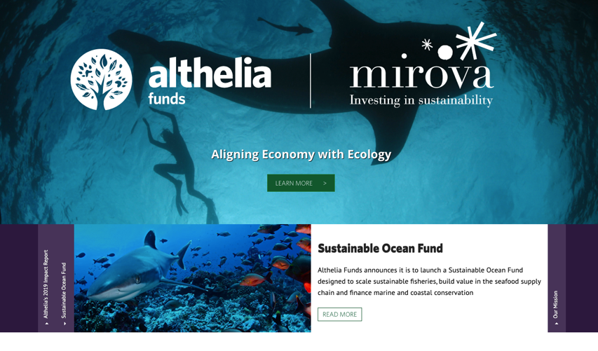
Return Based Investments: Examples
Microfinance – Village Savings and Loan Associations
Private Equity - Blue Ocean Partners
https://www.blueoceanspartners.com/
Impact Investing – Althelia/Mirova

Slide 18
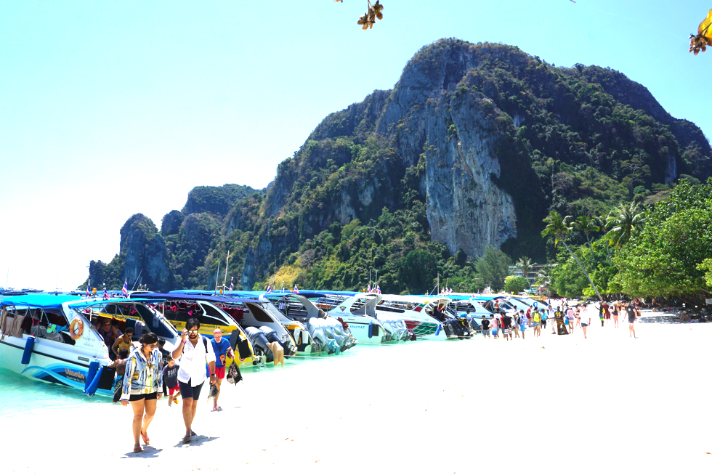
Economic Instruments: Examples
Green Taxes
Tourism Entrance Fees
Tradable Fisheries Quotas

Slide 19
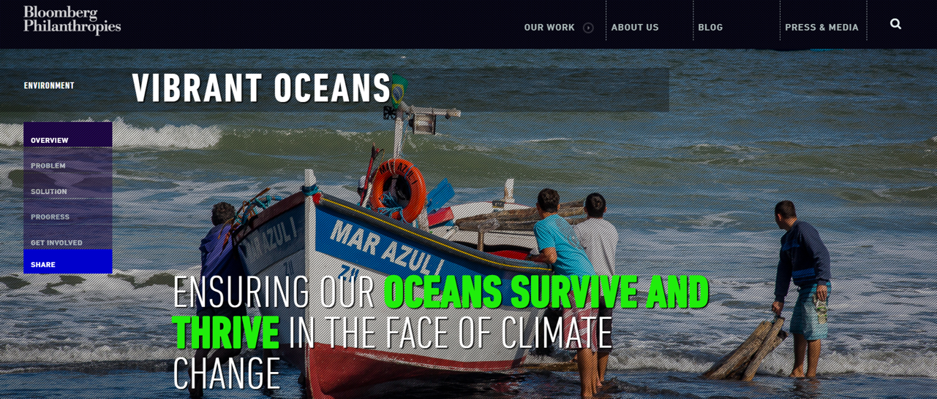
Grants and Other Transfers: Examples
Private and Corporate Philanthropy – The Vibrant Ocean Initiative (previously termed 50 Reefs)
Conservation Trust Funds / Environmental Funds – RedLAC, CFA Environmental Funds toolkit

Slide 20
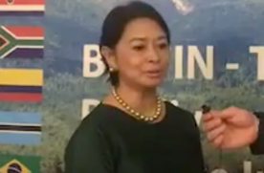
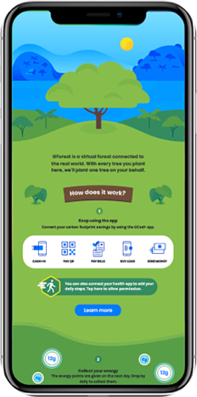
BIOFIN Country Example
The Philippines
Congresswoman Josephine Ramirez-Sato
1. New Protected Area Budget
2018: New PA Law (E-NIPAS) +> increases the number of gazette PAs from 13 to 107
2019: New PA regulations adopted
2020: New budget proposal adopted by Congress of US$ $46 Million
2. Payment Platform with Gcash
2019: Launch and initial contribution of US$500,000 for tree planting in watersheds with a landscape conservation approach
Notes:
The Philippines has been a frontrunner country from the start. They work with a congresswoman to pass the legislation. In 2018 a new law on protected areas was passed, formally gazetting over 90 sites. During the policy analysis stage the team had observed most protected areas did not receive much budget as they were not formally written into legislation. They are working on two more laws and also helped develop a new investment programme for Coastal and Marine Ecosystems, enabling new investments of around $ 11 Million. Other mechanism include a gaming app, working on remittances and launching a new platform to plant real trees called Gcash Forest, where users through virtual activities plant virtual trees, after which Gcash pays for the planting of real trees in multiple watersheds. Recently, protected area regulations are also approved and parliament prepared a 25 $ Million proposal for the 2020-21 budget year that has been tentatively endorsed.

Slide 21
Public Financial Management: Examples
Fiscal Transfers – Portugal’s “Local Finances Law”
Government Grants – Conservation Innovation Grants, USDA (USA)
Earmarking Revenues for Nature – Gasoline taxes, Costa Rica

Slide 22
Financial Efficiency: Examples
Mainstreaming Biodiversity in Development – Working for Water program, South Africa
Public Private Partnerships – African Parks

Slide 23
Additional Resources
BIOFIN Catalogue – www.biodiversityfinance.org
CFA Website – www.conservationfinancealliance.org
CFA Guide – www.conservationfinance.info
UNDP Financing Solutions for SDGs http://www.undp.org/content/sdfinance/en/home.html
OECD PINE Database - https://pinedatabase.oecd.org/

Slide 24
Future Directions
Conservation Finance Guide
Applying structure to existing resources- e.g. the 160+ Mechanisms in BIOFIN Guide
Accounting for Conservation / Biodiversity Expenditures and finance needs.
Define specific targets in each Class/Category

Slide 25
Thank you
Please visit our website at www.cfalliance.org to see the latest Conservation Finance news, sign up for our newsletter, or become a CFA member.

Slide 26
Return-Based Investments
Microfinance
Peer-to-Peer (P2P) Investing and Crowdfunding
Angel Investing, Incubators and Venture Capital
Private Equity
Debt: Leasing, Bank Loans, Notes, and Trade Finance
Capital Markets
Sustainable Investment Strategies

Slide 27
Economic Instruments
Environmentally Related Taxes
Fees and Charges
Tradable Resource Use Permits
Fines and Penalties
Compensation and Offsets
Deposit-refund Schemes
Environmentally Motivated Subsidies
- Built from the OECD PINE Database

Slide 28
Grants and Other Transfers
Official Development Assistance (ODA)
Private and Corporate Philanthropy
Remittances
Conservation Trust Funds / Environmental Funds

Slide 29
Business and Markets
Supply Chain Resilience
Conservation Businesses
Corporate Social Responsibility and Sustainability
Voluntary Offsets

Slide 30
Public Financial Management
Public Fiscal Planning, Budgeting and Disbursement
Fiscal Transfers
Government Grants
Reforming Harmful Subsidies
Earmarking Revenues for Nature

Slide 31
Risk Management
Insurance Products
Pay for Success
Blended Finance

Slide 32
Financial Efficiency
Management Effectiveness
Public Private Partnerships
Integrated Accounting
Mainstreaming Biodiversity in Development

